Slide 1


NoSQL Data Management
Department of Computer Science Engineering
School of Engineering

Slide 2
Module 2 : Distributed Data Systems and Consistency Models
Distributed Data Systems and Consistency Models Distribution Models: Single Server, Sharding, Master-Slave Replication, Peer-to-Peer Replication, Combining Sharding and Replication Consistency, Update Consistency, Read Consistency, Relaxing Consistency, The CAP Theorem, Relaxing Durability, Quorums. Version Stamps, Business and System Transactions, Version Stamps on Multiple Nodes.

Slide 3
Session Summary
Topics
Distribution Models, Consistency Models
Coordination & Agreement Techniques
BASE
CAP-Theorem, Version Stamps, Transactions, Quorums
Learning Outcomes (LOs)
LO1: Explain the different distribution models (single server, sharding, replication techniques)
LO2: Differentiate between update consistency, read consistency, and relaxed consistency models, and analyze how the CAP theorem influences distributed database design.
LO3: Apply concepts of durability relaxation, quorum-based approaches, and version stamps to ensure reliability and fault tolerance in distributed data systems.
LO4: Integrate business and system transaction requirements with version stamping across multiple nodes to design scalable and consistent distributed architectures.

Slide 4
Distributed Data Systems and Consistency Models

Slide 5
Introduction
What is a Distributed System?
Distributed Data Systems – databases and storage systems that manage data across multiple servers or locations.
Modern applications (social media, e-commerce, banking) store huge amounts of data.
┌─────────────────┐
│ User Request │
└───────┬─────────┘
│
┌───────────────┼────────────────┐
│ │ │
▼ ▼ ▼
┌───────────┐ ┌───────────┐ ┌───────────┐
│ Node A │ │ Node B │ │ Node C │
│ (Shard 1) │ │ (Replica) │ │ (Shard 2) │
└───────────┘ └───────────┘ └───────────┘

Slide 6
Introduction
Why distribution is needed?
Modern applications (social media, e-commerce, banking) store huge amounts of data.
Single Server can’t handle this data.
NoSQL databases (MongoDB, Cassandra, Couchbase, DynamoDB, etc.) are often distributed for scalability and fault tolerance.

Slide 7
Key Features
Data is stored in multiple machines.
Nodes communicate over a network
Users see it as one logical database
Example:
Facebook : Your profile data is stored in one server, photos in another, messages in another --- all linked together.
Why NoSQL uses distributed systems ?
Scalability – Handle billions of records by adding more machines.
Fault Tolerance – If one machine fails, others still serve data.
High Availability – Users can access data anytime, from anywhere.
Low Latency – Data stored close to where it’s used.

Slide 8
Challenges in Distributed Systems
Data Duplication – Copies of the same data exists on multiple nodes.
Network Delays – Updates take time to reach all nodes.
Conflicts – What if two users update the same record at the
same time.
CAP Theorem –
In a distributed system, you can only guarantee two of the following at the same time:
Consistency (C)
Availability (A)
Partition Tolerance (P) : The system will continue to operate and process requests even if a network failure causes a communication breakdown, or "partition," between different nodes or parts of the system.

Slide 9
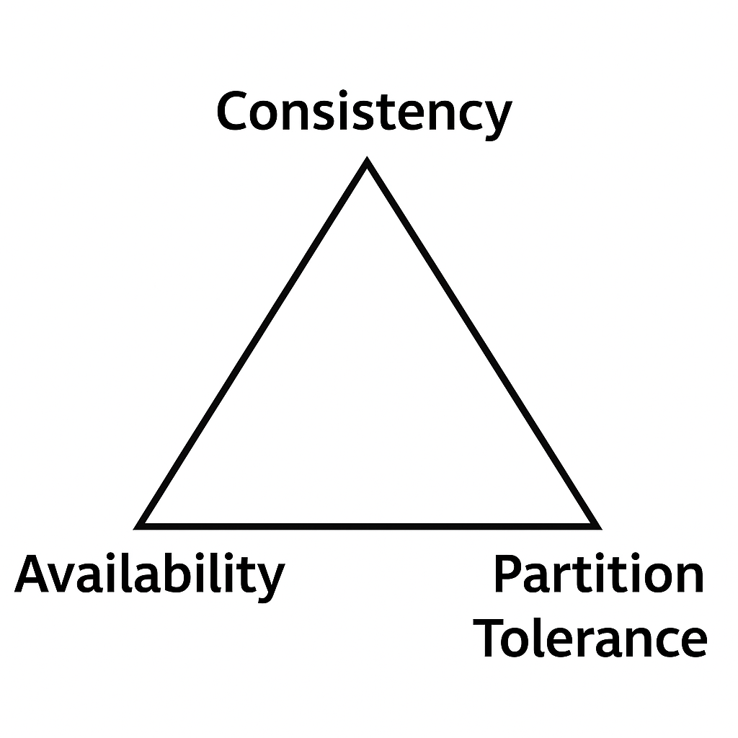
Challenges in Distributed Systems
CAP Theorem –
Consistency (C) : Every read gets the latest, correct data (same across all nodes).
After you write (update data), all nodes must agree before confirming success.
Systems prioritizing Consistency may delay responses but never show wrong balances.
Example:
You transfer ₹1000 from Account A to Account B.
Once confirmed, no matter which ATM or branch you check, your balance is updated immediately.
Systems prioritizing Consistency may delay responses but never show wrong balances.

Slide 10
Challenges in Distributed Systems
CAP Theorem –
Availability (A): Every request gets a response, even if it may not be the latest.
Each node responds with the data it has, even if it’s slightly outdated.
Fast responses, but sometimes stale or inconsistent data.
Example:
In an e-commerce site, two users try to buy the last item.
System allows both to purchase (both get a response), but inventory may show negative temporarily.
Prioritizes Availability over strict correctness.

Slide 11
Challenges in Distributed Systems
CAP Theorem –
Partition Tolerance (P): The system continues to work even if network breaks and nodes can’t communicate.
Partition: Part of a distributed System.
The cluster splits into “partitions” and each part keeps working independently.
You must choose between Consistency or Availability during the partition.
Example:
A global social network (like Facebook) with servers in India and the US.
If the link between them breaks, users in India can still post, and users in the US can still post — but they won’t see each other’s updates until the partition is fixed.

Slide 12
Challenges in Distributed Systems
CAP Theorem –
Each distributed system can choose only two guarantees:
CA → Consistency + Availability (possible only in single-node or non-partitioned systems).
CP → Consistency + Partition tolerance.
AP → Availability + Partition tolerance.

Slide 13
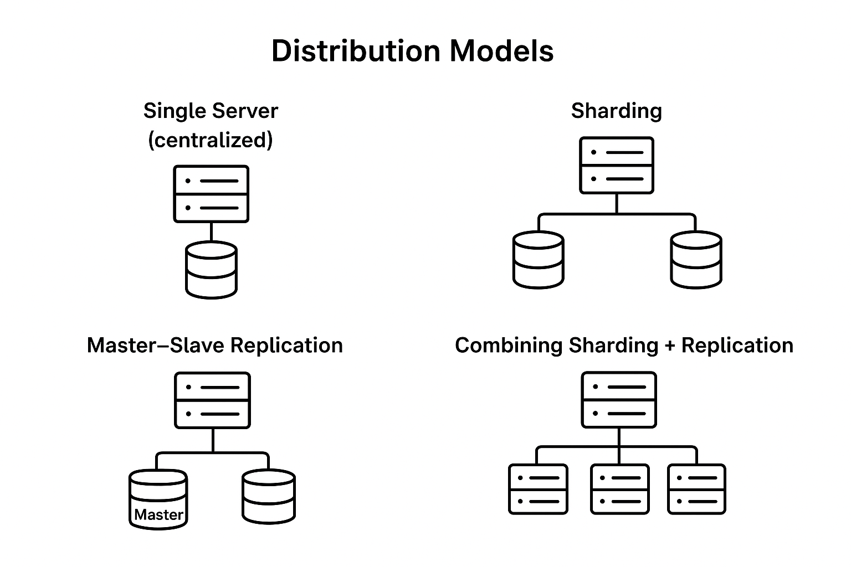
Distribution Models
1. Single Server (centralized):
All data is stored in a single server. Clients directly connect to this one server.
Advantages:
Simple to design and manage.
Strong consistency (only one copy of data).
Limitations:
Not scalable for large datasets or high traffic.
Single point of failure (if the server goes down, the system is unavailable).
Example: Small websites or applications with limited users.

Slide 14
Distribution Models
2. Sharding (Horizontal Partitioning):
The dataset is split into partitions (shards), and each shard is stored on a different server.
Advantages:
Improves scalability (data spread across multiple machines).
Balances load by distributing queries.
Limitations:
Complex to manage queries (must know which shard has the data).
Rebalancing is required if shards grow unevenly.
Example: MongoDB, Cassandra use sharding for handling massive datasets.

Slide 15
Distribution Models
3. Master–Slave Replication:
One server acts as the Master (handles writes) and multiple Slaves replicate the data (handle reads).
Advantages:
Increases read performance (slaves serve read queries).
Provides redundancy and backup.
Limitations:
Master is a single point of failure.
Data is eventually consistent between master and slaves (slight delay).
Example: MySQL replication, PostgreSQL replication setups.

Slide 16
Distribution Models
4. Peer-to-Peer Replication:
Every node acts as both a reader and writer. Updates are propagated among peers.
Advantages:
No single point of failure.
Good fault tolerance and scalability.
Limitations:
Conflict resolution is complex (two peers may update the same record differently).
Example: CouchDB, DynamoDB, Cassandra (multi-master setups).

Slide 17
Distribution Models
5. Combining Sharding + Replication:
Each shard (partition) is replicated across multiple nodes.
Advantages:
Scalability (due to sharding).
Fault tolerance & high availability (due to replication).
Limitations:
Higher complexity in system design.
Requires sophisticated coordination between shards and replicas.
Example: Google Spanner, HBase, modern distributed SQL databases.

Slide 18

Distribution Models : Single Server (centralized)
1. Single Server (centralized):
All data is stored in a single server. Clients directly connect to this one server.
Advantages:
Simple to design and manage.
Strong consistency (only one copy of data).
Limitations:
Not scalable for large datasets or high traffic.
Single point of failure (if the server goes down, the system is unavailable).
Example: Small websites or applications with limited users.

Slide 19
Distribution Models
Summary :
Single server → simplest, but limited.
Sharding → scales horizontally.
Replication → improves availability and fault tolerance.
Sharding + Replication → combines the best of both worlds.

Slide 20
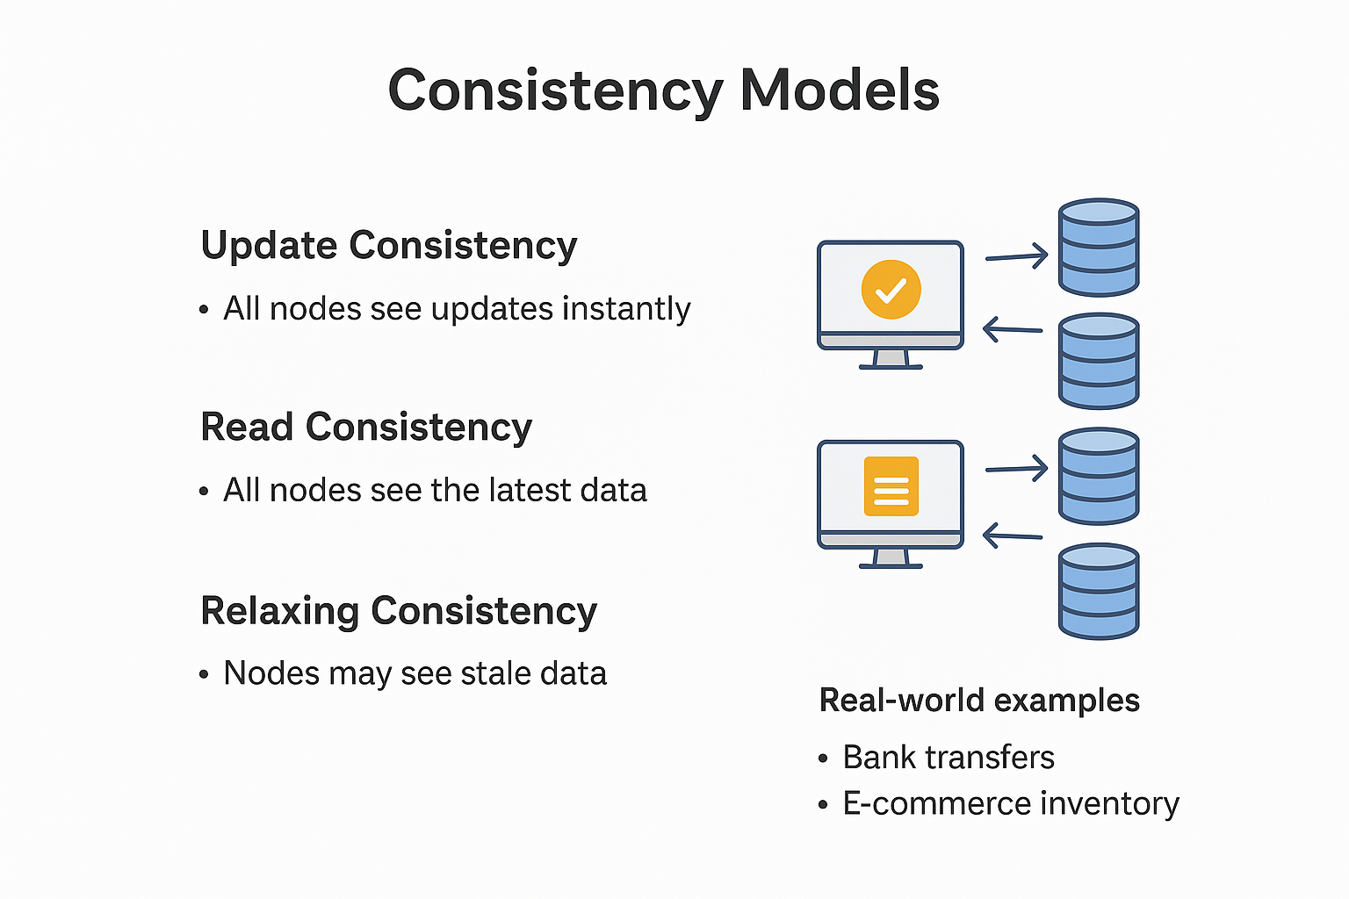
Consistency Models
Update Consistency
Read Consistency
Relaxing Consistency
Real-world examples (bank transfers, e-commerce inventory).

Slide 21
Consistency Models
Update Consistency: Once a write (update) is completed, all replicas in the system eventually reflect the same final value.
Guarantee: All replicas converge to the same state after the updates.
Focus: The correctness of write operations.
Example (Bank Transfer):
You transfer ₹1000 from Account A to Account B.
Even if network delays occur, eventually both accounts will show the correct balances.
Once updates are propagated, no ATM or branch will show conflicting balances.

Slide 22
Consistency Models
Read Consistency: The guarantee about what readers see after a write.
Levels:
Strong Consistency: Every read returns the most recent write.All replicas converge to the same state after the updates.
Eventual Consistency: Reads may return stale data, but eventually converge to the latest value.
Causal Consistency: Reads respect the cause-effect order of operations.
Example:
Last item in stock → User A buys it.
With Strong Consistency, when User B checks inventory, it immediately shows "Out of Stock".
With Eventual Consistency, User B might still see "1 item available" for a short while, even though it’s sold out.

Slide 23
Consistency Models
Relaxing Consistency: Sacrificing strict consistency rules to improve performance, availability, and scalability.
Why? Because in large distributed systems, always enforcing strict consistency is costly.
Approach: Allowing temporary inconsistencies that resolve later.
Example:
Shopping Cart Service (Amazon, Flipkart):
When you add items to cart, different servers
may not synchronize immediately.
Relaxed consistency ensures that you can still
add/view items smoothly, even if updates
take a second or two to sync across regions.
Social Media Likes (Facebook/Instagram):
You may like a post, but your friend doesn’t
see your like instantly due to relaxed
consistency.

Slide 24
Quorums
A quorum is a minimum number of votes or acknowledgments required from nodes in a distributed system to consider a read or write operation valid and successful. This mechanism helps ensure consistency and availability in the face of network partitions or node failures.
There are typically two types of quorums used in distributed systems:
Write Quorum (W): The minimum number of replicas that must acknowledge a write operation before it is considered successful. This ensures that the data is sufficiently replicated across the system to maintain consistency.
Read Quorum (R): The minimum number of replicas that must be accessed for a read operation to return a valid result. This ensures that the read operation reflects the most recent write, maintaining consistency from the user’s perspective.
The relationship between the number of nodes you need to contact for a read (R), those confirming a write (W), and the replication factor (N) can be captured in an inequality: W>N/2 , R+W>N

Slide 25

Transactions in Distributed Systems
Business Transactions (application-level)
System Transactions (database/system-level)
How transactions interact with consistency

Slide 26
Business and System Transactions
Business transactions refer to meaningful activities or interactions that occur in the context of a business operation. These transactions typically involve the exchange of goods, services, or information and have a direct impact on the organization's financials or operational processes.
Examples include sales transactions, purchase orders, inventory management, and customer interactions.
System transactions, on the other hand, refer to the operations performed by a database management system (DBMS) to ensure the integrity and consistency of data during business transactions.
These transactions are fundamental to the functioning of the database and follow the ACID (Atomicity, Consistency, Isolation, Durability) properties to guarantee reliable processing.

Slide 27
Version Stamps
Purpose of versioning
Version stamps in multiple nodes
Conflict resolution

Slide 28
Version Stamps on Multiple Nodes
Version stamps on multiple nodes are a crucial mechanism in distributed systems, enabling the tracking and management of data versions across different replicas or nodes. This approach helps maintain consistency, resolve conflicts, and ensure data integrity in environments where concurrent updates may occur.
In a distributed system, each node maintains its own version stamp for data items, which can be either logical timestamps, vector clocks, or physical timestamps.
When a node performs an update to a data item, it associates the update with its current version stamp. This versioning allows the system to track changes and determine the most recent version of the data across all nodes.
Logical Timestamps: Each update is assigned a unique logical timestamp based on the order of operations. If two nodes perform updates concurrently, their timestamps help in determining the sequence of updates.
Conflict resolution

Slide 29
Version Stamps on Multiple Nodes
Vector Clocks: Each node maintains a vector clock that counts the number of updates it has made and tracks updates from other nodes. When a node updates a data item, it increments its own entry in the vector clock and may also compare its vector with others to resolve conflicts
Physical Timestamps: In systems using physical timestamps, each update is time-stamped based on real-time. However, this approach can face challenges related to clock synchronization across nodes.

Slide 30
Question Bank
SL.No | Questions | LOs
1 | Define NoSQL Database and List the different types of NoSQL Database. | LO1
2 | Explain Key-Value pair Database. | LO1
3 | Explain Column-oriented databases. | LO1
4 | Explain Document-Oriented database. | LO1
5 | Explain Graph Based Database. | LO1
6 | Explain Concurrency and integration with an example. | LO3
7 | Explain ACID Properties with an example. | LO2
8 | Describe the history of NoSQL. | LO4
9 | List the feature of NoSQL. | LO4

Slide 31


